Slide 1
Advanced Workloads on Azure
Notes:
Suggested introduction:
Faced with _______
We did _______
And discovered_______

Slide 2
Agenda
What is an Advanced Workload?
Licensing & Support
Capacity Planning
Networking & Security
High Availability & Disaster Recovery

Slide 3
Advanced Workload
An advanced workload is a workload consisting of multiple (infrastructure) components with high-end requirements for connectivity, security, performance, and availability.

Slide 4
Advanced Workload Examples
3rd Party
SAP
Oracle
DB/2
… and many more
Microsoft
BizTalk
Dynamics
SharePoint
SQL Server
Notes:
Advanced workloads come in many forms. Microsoft has its fair share of solutions that require and advanced configuration, regardless of whether this is on-premises or in the cloud. SharePoint and Dynamics are key examples of workloads that can be huge and complex. When it comes to third party workloads there are many, but SAP, Oracle, and DB/2 are prime examples. In this session we are focusing on these types “traditional” of workloads that require a complex hardware setup. More modern workloads, such as Big Data & Analytics workloads, containers etc. have different considerations when run in Azure.

Slide 5
On-premises versus cloud benefits
On-premises
Hyper-scale public cloud
Traditional server/storage/network hardware with backup/HA solutions can be costly
Hardware cost savings on hyper-scale cloud infrastructure with built-in HA/DR functionalities
1
Sizing is often difficult and customers realize hardware/hosting vendors oversized after rollout
Systems can scale up/out/down depending on system workload
2
People to run systems on-premises without automation solutions is the biggest cost factor
Automated administration helps IT focus on more strategic tasks
3
Customers cannot afford having a second datacenter for disaster recovery and tend to rely on old-style tape backup
DR environment can be instantly set up without affecting existing production environment
4
Dev/test/QA busy during implementation but go idle after go-live; except QA for trouble shooting
Dev/test/QA can be “parked” to minimize compute costs
5
Notes:
The first question is always one from a business perspective: why would I run these advanced workloads in the Cloud? Particularly if they are on average running well on-premises. Ultimately that comes down to one thing: the quality of service per dollar spent. Cloud has several characteristics that enable you to lower cost and improve the quality of service at the same time. Compared to on-premises, cloud provides cheaper hardware and hardware operating cost, the ability to scale up/out/down, less costly disaster recovery, and a high degree of automation. Disaster recovery and automation are often an afterthought in on-premises scenarios, and that can seriously compromise the quality of service, and incur high remediation cost.

Slide 6
Licensing & Support
Notes:
When you bring workloads to Azure one of the key concerns is licensing and support. It is key for business to know that if something goes wrong, they are covered by support. It is also important to ensure that no unneeded licenses are being paid for, or it turns out you need to pay much more than you are when an audit is done.

Slide 7
Pay-As-You-Go License
License included with the VM
License fee collected via your Azure bill
Great for elastic workloads
Notes:
In the cloud we have two forms of licensing. The first is Pay-As-You-Go (PAYG), in which case the license is included with the VM you provision from an image in the Azure Marketplace. This means that the license fee is collected through the Azure bill, and you only pay licensing cost when the VM is deployed. When you turn the VM off, you are not charged for the license. This is extremely useful for elastic workloads, as your licensing cost is kept low when there is limited traffic, and grows as traffic grows. This also means that you are never at risk of surpassing your licensing limit.
Many people assume that when they provision a VM with software included, that they are automatically licensed, but that is not the case. It is important to look at license agreement when you provision a VM.

Slide 8
Bring Your Own License
When VM doesn’t include license
When installing software yourself
Some licenses are not Cloud compatible
Check for license mobility
Notes:
BYOL applies when you install software yourself, or when a VM you provision from an image in the gallery doesn’t include a license. In the latter case the software may already be installed according to the best practices of the vendor, but you acquire the license from the vendor.
Be aware that when you install software yourself, you need to check whether the license is actually cloud compatible. Most are these days, but some may still exist that actually require you to license the underlying hardware, which in the case of cloud could be the entire cloud data center!
When you migrate an advanced workload to the cloud, you may be able to use your existing licenses. If the vendor support license mobility, you can build up your new environment in Azure without having to acquire new licenses on top of your existing licenses. If the vendor does not support license mobility, check with the vendor how to minimize licensing cost while transitioning to Azure.

Slide 9
Supported or Certified
Most x86 workloads on Windows/Linux will work
Microsoft supports services / infrastructure
Determine vendor support policy
Check if combination is supported
Certified software has been tested by the vendor
Supported Microsoft Server software: KB2721672
Linux and OOS support policy: KB2941892
Notes:
Most x86 software on Windows or Linux will run on Azure, regardless of whether the vendor made sure it does. Only software with very specific needs, for example software that ties in to specific hardware or hypervisor will not work on Azure. However, that software runs on Azure doesn’t necessarily mean the vendor supports it. Microsoft in most cases just provides support on the services, which in case of advanced workloads means cloud infrastructure components such as VMs, storage, networking components, and services such as Azure Backup and Azure Site Recovery. But if you have issues specific to certain software, Microsoft may not be able to provide a fix.
Some vendors will just not support you if you run their software on Azure (or any other cloud). That means that if you run into an issue and Microsoft is unable to fix it, you are pretty much out of luck. For production workloads the business risk associated with that scenario is probably too high, but you could still use Azure for development and test purposes.
If deployment in Azure is supported, you should still check for any small print. Basically, it is important to determine what the vendor’s support policy is when running on Azure. Another thing to check carefully is whether the combination of software you want to run is supported. For example, you can run SAP with an Oracle database on Azure, but only if the Oracle database runs on Windows. If you want to run SAP on Linux, you need to use another database
Having support from the vendor is one thing, but it’s even better when the vendor has certified the software for use with Azure. When a vendor certifies software, it is put through a rigorous test process to ensure the software works well on Azure. This is a similar process to certifying specific hardware or virtualization software.

Slide 10
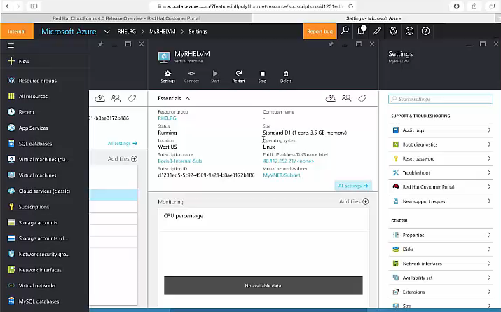
Red Hat + Microsoft: Integrated Support
Support staff from Red Hat & Microsoft co-located @Redmond
Red Hat & Microsoft security response team collaboration
Red Hat Technical Account Management & Microsoft Premier Services
Red Hat participation in Azure forums
Integrated ticketing systems
http://aka.ms/redhatazure
Notes:
Usually support is divided between Microsoft for the underlying infrastructure, and the software supplier for the software you run on top of it. Red Hat and Microsoft have created an industry-changing integrated support model for customers using Red Hat solutions in Azure. We are working side-by-side to solve common problems and to provide the enterprise-grade support that customers rely on in their datacenters. As part of our agreement Red Hat and Microsoft staff is co-located in Redmond, so you deal with one support desk instead of two. The ticketing systems of Red Hat and Microsoft also are integrated. In addition Red Hat participates in our Azure Forums, collaborates with our security response team. For the best experience you need to link your Azure account and Red Hat account.
The Red Hat agreement includes Red Hat Enterprise Linux Atomic Host, Red Hat JBoss Enterprise Application Server, Red Hat JBoss Enterprise Web Server, Red Hat Gluster Storage, and OpenShift by Red Hat.

Slide 11
SAP NetWeaver certifications
SAP and Microsoft have tested and certified Microsoft Azure IaaS against the same standards as those used for on-premises infrastructure. The table below shows a list of product certified today.
SAP Solution | Guest OS | Database | VM Types
SAP Business Suite | Windows Server; SUSE Linux Enterprise Server (SLES) | SQL Server; Oracle; DB2²; SAP ASE³ | A5-A11, D11-D14, DS11-DS14, DS11v2-DS14v2, GS1-GS5
SAP Business All-in-One | Windows Server; SLES | SQL Server; Oracle; DB2²; SAP ASE³ | A5-A11, D11-D14, DS11-DS14, DS11v2-DS14v2, GS1-GS5
SAP Business Objects (BI) | Windows Server | NA | A5-A11, D11-D14, DS11-DS14, DS11v2-DS14v2, GS1-GS5
SAP NetWeaver¹ | Windows Server; SLES | SQL Server, Oracle; DB2²; SAP ASE³ | A5-A11, D11-D14, DS11-DS14, DS11v2-DS14v2, GS1-GS5
¹Only NetWeaver 7.00 and later SAP releases of NetWeaver are supported for deployment in Azure ²Oracle Database 11g R2 Patchset 3 (11.2.04 ), Single Instance ³SAP Adaptive Server Enterprise 16
Notes:
SAP has certified various workloads on Azure, and there is guidance detailing the expected performance levels on different VM types. All databases certified for SAP are available, but you need to be aware of some OS restrictions.

Slide 12
SAP ^{HANA} certifications
SAP Solution | Supported OS | Azure Offerings
SAP HANA Developer Edition (including the HANA client software comprised of SQLODBC, ODBO-Windows only, ODBC, JDBC drivers), HANA studio, and HANA database)¹ | SUSE Linux Enterprise Server (SLES) | A5-A11, D11-D14, DS11-DS14, GS1-GS5
SAP HANA One | SLES | DS14_v2 (upon general availability)
SAP S/4HANA | SLES | Controlled Availability for GS5² SAP HANA on Azure (Large Instances) upon general availability
SAP Business Suite on HANA (OLTP) | SLES | SAP HANA on Azure (Large Instances) upon general availability
SAP HANA Platform or Enterprise Edition for SAP BW (OLAP) | SLES | SAP HANA on Azure (Large Instances) upon general availability
¹ Customers can try SAP HANA Developer Edition on Azure using the SAP Cloud Appliance Library.
² Contact your Microsoft or SAP account manager for more information
Notes:
SAP HANA is also certified to run in Azure. The Developer Edition can run on various larger VM sizes, and SAP HANA One is certified for DS14_v2 where available. For larger HANA production workloads Microsoft has specialized instances that have been certified on Azure. We will look more at what that looks like architecturally later in this session.

Slide 13
Capacity Planning
Notes:
A major question customers ask is: what will it cost to run system X in Azure?
Although Azure is Pay-per-Use, you will definitely not get away with “you pay for what you use.” If a workload is highly elastic, you will be able to show the cost benefit of running in Azure, but you will need to provide some way to estimate which services you will be using and at cost.
We will discuss the general factors involved in capacity planning for advanced workloads, and we’ll look at two example workloads: SAP and Oracle.

Slide 14
Planning Compute
SKU | Azure Compute Unit (ACU)/Core | CPU Type
A0-A7 | 50 | Not specified
A1-A7 | 100 | Not specified
A8-A11 | 225* | 2.6 GHz Intel® Xeon® E5-2670
D1-D14/DS1-DS14 | 160 | Not specified
D1v2-D15v2/DS1v2-DS15v2 | 210-250* | 2.4 GHz Intel® Xeon® E5-2673 v3
F1-F16/FS1-FS16 | 210-250* | 2.4 GHz Intel® Xeon® E5-2673 v3
G1-G5/GS1-GS5 | 180-240* | Intel® Xeon® E5 v3 family
NC6-NC24/NV6-NV24** | TBA | 2.9 GHz Intel® Xeon® E5-2690 v3
* Uses Intel® Turbo technology to increase CPU frequency and provide a performance boost. The amount of the
boost can vary based on the VM size, workload, and other workloads running on the same host. ** In preview
Source: https://azure.microsoft.com/en-us/documentation/articles/virtual-machines-linux-sizes/
Notes:
To plan the needed Compute capacity in Azure means mapping your on-premises hardware capacity to what is available in Azure. This is not a 1-to-1 mapping, especially if you are using bare-metal servers on-prem. There is no definitive way to compare on-prem PassMark CPU benchmark score against Azure cores, so you need to do some tests. However, the Azure Compute Unit (ACU) per Core on this slide does tell you about the power of the CPU cores in different VM SKUs in Azure, basically telling you how much bang you get for your buck.
In a migration scenario you are likely migrating from older hardware, as the ROI is lower if you have brand new hardware. With that in mind, you could start off with doing a 1-to-1 mapping of the number of on-prem cores to the number of cores in Azure (not counting A0-A7), and keeping a margin for safety. For a paper exercise that in most cases puts you at the high end of the spectrum of capacity you need. And because you can easily scale down, you can then save even more cost once you actually start moving workloads.
One thing to remember when doing capacity planing is that in Azure any workload needs to run at least two instances in an Availability Set to fall under then 99.95% SLA for Azure services. If a workload runs on a single machine in your on-prem data center, you need to account for splitting the workload over two machines. In an active-passive scenario the both VM instances need to be able to run the workload from the on-prem environment. In an active-active scenario you need to determine whether the workload scales linearly or not. If not, you need to use VM instances that together have slightly more capacity than the original server.

Slide 15
Planning Memory
A-Series
D/DS-Series
F/FS-Series
G/GS-Series
SKU | #Cores | GB RAM
A0 | 1 | 0.768
A1 | 1 | 1.75
A2 | 2 | 3.5
A3 | 4 | 7
A4 | 8 | 14
A5 | 2 | 14
A6 | 4 | 28
A7/A8/A10 | 8 | 56
A9/A11 | 16 | 112
SKU | #Cores | GB RAM
D1/D1v2 | 1 | 3.5
D2/D1v2 | 2 | 7
D3/D1v2 | 4 | 14
D4/D1v2 | 8 | 28
D5v2 | 16 | 56
D11/D1v2 | 2 | 14
D12/D1v2 | 4 | 28
D13/D1v2 | 8 | 56
D14/D1v2 | 16 | 112
D15v2 | 20 | 140
SKU | #Cores | GB RAM
F1 | 1 | 2
F2 | 2 | 4
F4 | 4 | 8
F8 | 8 | 16
F16 | 16 | 32
SKU | #Cores | GB RAM
G1 | 2 | 28
G2 | 4 | 56
G3 | 8 | 112
G4 | 16 | 224
G5 | 32 | 448
H-Series
SKU | #Cores | GB RAM
H8 | 8 | 56
H8m | 8 | 112
H16/H16r | 16 | 112
H16m/H16mr | 16 | 224
NC/NV-Series
SKU | #Cores | GPU | GB RAM
NC6/NV6 | 6 | 1xK60/1xM60 | 56
NC12/NV12 | 12 | 2xK60/2xM60 | 112
NC24/NV24 | 24 | 4xK60/4xM60 | 224
Notes:
Planning for memory is much simpler than planning for Compute. With memory it is only a question of mapping the on-prem size and getting the same size in Azure. There is only one gotcha: the memory size is fixed per instance size. You can’t just say I want X cores with Y GBs of memory. That means you need to look at the Compute and Memory requirements for an application, and then pick the size that is the closest match. When the closest match has slightly less memory than the original system, you need to check whether you have enough free memory to be able to downsize or make minor configuration changes to make it possible. The alternative may be going up another step on the ladder, but if you have a CPU based license may seriously affect the license cost. This is where the different series of VMs in Azure are important.
The A, D, Dv2, DS, and DSv2 variants are general purpose VMs with an average CPU to GB RAM ratio. Both of these series have a “low-memory” variant and a “high memory” variant. The F-series are heavy compute instances, and as such offer high-end CPUs with limited RAM. The G-series are at the other end of the spectrum, offering 14GB of RAM per CPU core. The N-series are for very compute intensive workloads such as HPC and graphical workloads. These machines come fitted with a GPU for high-end processing, and fairly high memory capacity.

Slide 16
Planning Storage
Standard Storage Disk
Premium Storage Disk
dev/test/generic workloads
Pay for what you use
Backed by HDD
Up to 500 IOPS*
60 MB/sec
~5ms latency
500TB per Storage Account*
Storage Analytics
Supported with any VM
* Max 20k IOPS per Storage Account
Ideal for I/O intensive workloads
Pay for what you provision
Backup by SSD
IOPS varies by size (500, 2300, 5000)
Throughput: 100, 150, 200 MB/sec
<1ms latency
35TB per Storage Account
VM Monitoring with Diagnostics Ext.
Supported with DS/FS/GS VMs
DS: up to 40 disks, 64K IOPS, 960 MB/s
GS: up to 80 disks, 80K IOPS, 2000 MB/s
Notes:
For advanced workloads planning storage for the most parts comes down to disk planning for the VMs in the solution. In some cases you may be able to refactor to use alternate types of storage, such as Blob Storage and SQL DB, but with a workload like SAP you have to work with IAAS services, and hence with VM disks. Because Azure doesn’t provide SAN storage, there are certain limitations you need to keep in mind. Solutions that typically require SAN storage, such as Oracle RAC won’t work. There may be workarounds that enable you to still use such technology, but you need to check carefully whether these are supported by the vendor.
When you work with disks, there are two major factors to consider: size and performance. Until managed disks become available you can’t attach more than 80TB of disk space, because you can’t attach more than 80 disks, with a maximum size of 1TB each. You then need to stripe these disks together to create a larger volume. Striping disks together has the added benefit that you increase the overall performance. Each disk has an IOPS limit, and when you stripe disks together the sum of the limits is the overall limit.
When it comes to performance you have a choice between Standard Storage and Premium Storage. Standard Storage is backed by HDD and has an average latency of around 5 milliseconds. One thing to note is that there is no SLA on performance, and even though the 5ms average holds, you may occasionally see individual I/O operations that take more than 1000 ms. For dev/test workloads, application servers and other generic workloads Standard Storage works fine, but for I/O intensive workloads you will need Premium Storage in most cases.
Another consideration is the size of a storage account and the IOPS limit of Standard Storage for the entire account. Standard Storage can store 500TB, but has an IOPS limit of 20,000 IOPS, which roughly translates to 40 disks. Premium Storage can hold up to 35TB per account. So if you want to create a VM with 80 disks attached, you will need multiple storage accounts for that VM in both cases.

Slide 17
SAP on Azure Performance
Tier | VM Types | VM Size | SAPS
2-tier | A5 | 2 CPU, 14 GB | 1,500
2-tier | A6 | 4 CPU, 28 GB | 3,000
2-tier | A7 | 8 CPU, 56 GB | 6,000
2-tier | A8 / A10 | 8 CPU, 56 GB | 11,000
2-tier | A9 / A11 | 16 CPU, 112 GB | 22,000
2-tier | D11 / DS11 | 2 CPU, 14 GB | 2,325
2-tier | D12 / DS12 | 4 CPU, 28 GB | 4,650
2-tier | D13 / DS13 | 8 CPU, 56 GB | 9,300
2-tier | D14 / DS14 | 16 CPU, 112 GB | 18,600
2-tier | DS11_v2 | 2 CPU, 14 GB | 3,530
2-tier | DS12_v2 | 4 CPU, 28 GB | 6,680
2-tier | DS13_v2 | 8 CPU, 56 GB | 12,300
2-tier | DS14_v2 | 16 CPU, 112 GB | 24,180
2-tier | DS15_v2 | 20 CPU, 140 GB | 30,430
2-tier | GS1 | 2 CPU, 28 GB | 3,580
2-tier | GS2 | 4 CPU, 56 GB | 6,900
2-tier | GS3 | 8 CPU, 112 GB | 11,870
2-tier | GS4 | 16 CPU, 224 GB | 22,680
2-tier | GS5 | 32 CPU, 448 GB | 41,670
Record SAP Cloud Benchmark: In October 2015, Microsoft released a Cloud Benchmark for SAP using GS-series VMs that beat a prior cloud record by a factor of 4, leveraging 45,100 SAP SD Users.
Benchmarks: SAP 2 Tier and 3 Tier standard SD Benchmark set.
Tier | VM Types | VM Size | SAPS
3-tier | A5 | 2 CPU, 14 GB | 12,000
3-tier | A6 | 4 CPU, 28 GB | 25,000
3-tier | A7 | 8 CPU, 56 GB | 50,000
3-tier | DS12 | 4 CPU, 28 GB | 48,750
3-tier | DS13 | 8 CPU, 56 GB | 91,050
3-tier | GS1** | 2 CPU, 28 GB | 34,415
3-tier | GS2** | 4 CPU, 56 GB | 78,620
3-tier | GS3** | 8 CPU, 112 GB | 137,520
3-tier | GS4** | 16 CPU, 224 GB | 247,880
Can support most SAP Business Suite workloads!
** The GS Series is only supported with DB Files and transaction log files on Premium Storage
Notes:
SAP measures performance in SAPS and along with the SAP certification process, SAP determines the SAPS for the different VMs. This makes capacity planning much easier. As you can see you can host very large SAP systems on Azure.
Blog Report: http://blogs.msdn.com/b/saponsqlserver/archive/2015/10/05/world-record-sap-sales-and-distribution-standard-application-benchmark-for-sap-cloud-deployments-released-using-azure-iaas-vms.aspx
Detailed Benchmark Data:
Benchmark Certification #2015042: Three-tier SAP SD standard application benchmark in Cloud Deployment type. Using SAP ERP 6.0 Enhancement Package 5, the results of 7000 SD benchmark users and 38415 SAPS were achieved using:
Deployment type: Cloud
1 x Azure VM GS2 with 4 CPUs and 56 GB memory running windows Server 2012 R2 Datacenter as Central Instance
1 x Azure VM GS5 with 32 CPUs and 448 GB memory running Windows Server 2012 R2 Datacenter for Dialog Instances
1 x Azure VM GS1 with 2 CPUs and 28 GB memory running Windows Server 2012 R2 Datacenter and SQL Server 2012 as DBMS instance
All VMs hosted on Azure nodes with 2 processors / 32 cores / 64 threads based on Intel Xeon Processor E5-2698B v3 with 2.00 GHz
More details: Link to SAP benchmark webpage follows as soon as SAP updated site with this benchmark result
-------------------------------------------------------------------------------------------------------------------------------------------
Benchmark Certification #2015043: Three-tier SAP SD standard application benchmark in Cloud Deployment type. Using SAP ERP 6.0 Enhancement Package 5, the results of 14060 SD benchmark users and 78620 SAPS were achieved using:
Deployment type: Cloud
1 x Azure VM GS2 with 4 CPUs and 56 GB memory running windows Server 2012 R2 Datacenter as Central Instance
2 x Azure VM GS5 with 32 CPUs and 448 GB memory running Windows Server 2012 R2 Datacenter for Dialog Instances
1 x Azure VM GS2 with 4 CPUs and 56 GB memory running Windows Server 2012 R2 Datacenter and SQL Server 2012 as DBMS instance
All VMs hosted on Azure nodes with 2 processors / 32 cores / 64 threads based on Intel Xeon Processor E5-2698B v3 with 2.00 GHz
More details: Link to SAP benchmark webpage follows as soon as SAP updated site with this benchmark result
-------------------------------------------------------------------------------------------------------------------------------------------
Benchmark Certification #2015044: Three-tier SAP SD standard application benchmark in Cloud Deployment type. Using SAP ERP 6.0 Enhancement Package 5, the results of 24500 SD benchmark users and 137520 SAPS were achieved using:
Deployment type: Cloud
1 x Azure VM GS2 with 4 CPUs and 56 GB memory running windows Server 2012 R2 Datacenter as Central Instance
4 x Azure VM GS5 with 32 CPUs and 448 GB memory running Windows Server 2012 R2 Datacenter for Dialog Instances
1 x Azure VM GS3 with 8 CPUs and 112 GB memory running Windows Server 2012 R2 Datacenter and SQL Server 2012 as DBMS instance
All VMs hosted on Azure nodes with 2 processors / 32 cores / 64 threads based on Intel Xeon Processor E5-2698B v3 with 2.00 GHz
More details: Link to SAP benchmark webpage follows as soon as SAP updated site with this benchmark result
-------------------------------------------------------------------------------------------------------------------------------------------
Benchmark Certification #2015045: Three-tier SAP SD standard application benchmark in Cloud Deployment type. Using SAP ERP 6.0 Enhancement Package 5, the results of 45100 SD benchmark users and 247880 SAPS were achieved using:
Deployment type: Cloud
1 x Azure VM GS2 with 4 CPUs and 56 GB memory running Windows Server 2012 R2 Datacenter as Central Instance
7 x Azure VM GS5 with 32 CPUs and 448 GB memory running Windows Server 2012 R2 Datacenter for Dialog Instances
1 x Azure VM GS4 with 16 CPUs and 224 GB memory running Windows Server 2012 R2 Datacenter and SQL Server 2012 as DBMS instance
All VMs hosted on Azure nodes with 2 processors / 32 cores / 64 threads based on Intel Xeon Processor E5-2698B v3 with 2.00 GHz
More details: Link to SAP benchmark webpage follows as soon as SAP updated site with this benchmark result

Slide 18
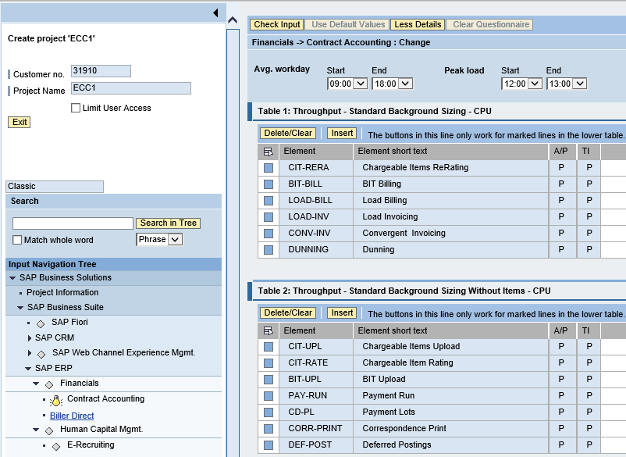
SAP System Sizing
SAP Quick Sizer
Existing systems
Reference on-prem configuration
Use resource utilization data
New Systems
SAP Quick Sizer
Notes:
Can’t give one-size fits all sizing advice and reference architectures. You need to base off some capacity guidelines.
For on-prem, use existing system config and resource utilization data. The system utilization information is collected by the SAP OS Collector and can be reported against via transaction OS06. Similar information can be retrieved from any system performance and statistics gathering tools.
For net new systems, use SAP quick sizer. The Quick Sizer can be found at https://service.sap.com/quicksizer. Access requires an OSS account.

Slide 19
SAP System Utilization Info
ABAP
SAP operating system monitor transaction OS07N
CPU
Memory Management
File systems and LAN
JAVA
SAP Netweaver Administrator (NWA)
Notes:
For ABAP stack servers, transaction OS07N reports CPU, memory, IO, and LAN information
You can use the operating system monitor to display operating system data from monitored hosts on which an operating system collector SAPOSCOL is running. You have the following options for selecting the data to be displayed:
You can determine the time period for which data is to be displayed. More information: Selecting Current Values and History of Operating System Data > http://help.sap.com/saphelp_nw70ehp3/helpdata/en/45/d0446d01ef0b00e10000000a1553f7/content.htm
You can determine the system and instance about the hosts of which data is displayed. More information: Selecting Operating System Data of Systems, Instances, and Hosts > http://help.sap.com/saphelp_nw70ehp3/helpdata/en/45/d043b401ef0b00e10000000a1553f7/content.htm
You can use different analysis views to determine which topic area of the monitored operating system data is to be displayed.
For Java stack application servers, the tool for monitoring and management is Netweaver Administrator (NWA). The Availability and Performance work center in SAP NetWeaver Administrator enables you to monitor different parameters of a system operation. Among other things, It includes the AS Java Statistics which allows you to measure and analyze the performance of AS Java system activities. It provides important performance metrics such as response time, CPU time, memory consumption, and so on.
After all, you can also rely on 3rd party system management tools available in the market to report on capacity and resource consumption for SAP sizing purposes.

Slide 20
Oracle DB Performance Optimization
Optimize for least CPU cores, most memory
Most cost impact (licensed per 2 cores)
Premium Storage often preferred
Disk allocation considerations
Logical volumes for different file types to make changes easily
(Repeatable) performance testing http://bit.ly/AzureStoragePerfOptimization http://bit.ly/Oracle12cAppReplay
Backup requirements
Notes:
Licensing fees by far outweigh VM and storage cost, so optimize for the least number of CPU cores required. BYOL Oracle licenses go per CPU core, with a core factor for intel based CPUs of 0.5. For Azure this effectively means Oracle licenses go per pair of CPU cores, which nicely aligns with the sizing options in Azure. Note that it does not make sense to use Oracle BYOL on a single CPU core VM such as an A1 or D1, because you are then only using half of the license. Considering Oracle’s use of memory, you should consider using instances with more memory per core, like D11 and up or G-series VMs.
Very few types of workloads perform well on Standard Storage. In most cases Premium Storage is preferred, mostly because of the latency difference. Standard Storage latency averages around 4-5 ms, whereas Premium Storage has a sub millisecond latency. Oracle Smart Flash Cache (Linux only) is designed to use local SSD storage to buffer for “slow” networked storage, but in most tests this does not yield the desired results. In fact, in some cases SMC has a negative impact on performance.
Although in some cases Standard Storage may be sufficient, IOPS are often the greatest bottleneck for an Oracle database. Premium Storage in that case works better than striping Standard Storage disks. To achieve 5000 IOPS with Standard Storage, you would need 10+ striped disks. That in most cases is still slower than a single P30 (1023 GB, 5000 IOPS) disk because of the latency. In addition, to add 10 disks you need a VM with 8 cores or more. Unless you need that many CPU cores, the additional licensing cost is far higher than the cost of a Premium Storage disk. We have seen examples of production workloads running faster than on-prem using just a single P30 disk. The same workload was 4 to 5 times slower than on-prem on Standard Storage with 5 striped disks.
To optimize the performance, you can use Performance Monitor to check CPU, memory, and IO load. In conjunction with Oracle App Replay you can create a repeatable test set and perform the same test with different configurations. The supplied links provide more information about this.

Slide 21
Networking & Security
Notes:
Networking also plays a role when doing capacity planning, but there is much more to networking, so we’ll spend some more time looking at networking and security.

Slide 22
The Big Networking Picture
Virtual Network
“Bring Your Own Network”
Segment with subnets and security groups
Control traffic flow with User Defined Routes
Azure
Virtual Network
Users
Internet
Front-End Access
Dynamic/Reserved Public IP addresses
Direct VM access, ACLs for security
Load balancing
DNS services: hosting, traffic management
DDoS protection
Backend Connectivity
Point-to-site for dev / test
VPN Gateways for secure site-to-site connectivity
ExpressRoute for private enterprise grade connectivity
Backend Connectivity
ExpressRoute
VPN Gateways
Notes:
Let’s talk about the big networking picture.
Virtual network: An Azure virtual network (VNet) is a representation of your own network in the cloud.
Bring your own network: Microsoft lets you bring you own network (BYON) into Windows Azure. You can connect your local area network (LAN) to Azure and an unlimited number of computers on your corporate networks can seamlessly communicate with VMs in Azure. You can specify private network spaces (such as 192.168.x.x and 10.x.x.x) in any range, size, and starting number to suit your existing network topology.
Segment with subnets and security groups: You can also further segment your VNet into subnets and deploy Azure IaaS virtual machines (VMs) and PaaS role instances, in the same way you can deploy physical and virtual machines to your on-premises datacenter. Network Security Groups provide control over network traffic flowing in and out of your services running in Azure.
Control traffic flow with User Defined Routes: With user defined routes, you now have complete control over the traffic flow in your virtual network. Virtual network by default provides system routes for traffic flow between virtual machines. You can now customize the routing table by defining routes allowing you to direct traffic through network appliances.
<Click>
Front-End Access: for the front end access, Microsoft Azure Virtual Private Network (VPN) provides multiple options to secure and manage VPN like, dynamic/reserved public IP address, ACL for security, load balancing etc…
<Click>
Backend Connectivity: With Microsoft Azure Virtual Private Network (VPN), you can create point-to-site VPN for your dev/test, create secure site-to-site connectivity with Azure VPN gateways and can opt for ExpressRoute for private enterprise grade connectivity.

Slide 23







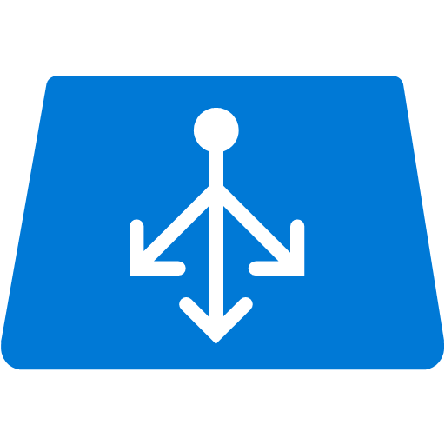


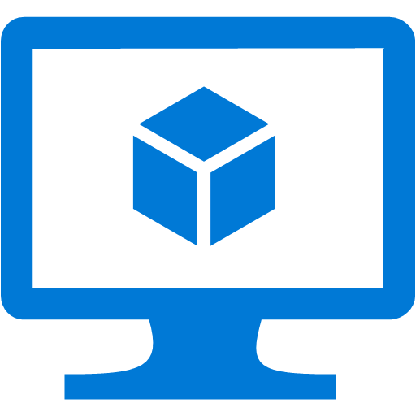



On-Premises (Physical) -2- Cloud (Virtual)
Internet
Router
Azure Infrastructure
Firewall
NSG
DMZ
Public Facing LB
S2S VPN
Frontend Subnet
Public Facing LB
Web Servers
DNS
Web Server VM’s
DNS
ExpressRoute
Firewall
NSG
Backend Subnet
Internal LB
Internal
Internal LB
Database Server VM’s
DC VM
Database Servers
DC
Virtual Network
Notes:
An Azure virtual network (VNet) is a representation of your own network in the cloud. You can control your Azure network settings and define DHCP address blocks, DNS settings, security policies, and routing. You can also further segment your VNet into subnets and deploy Azure IaaS virtual machines (VMs) and PaaS role instances, in the same way you can deploy physical and virtual machines to your on-premises datacenter. In essence, you can expand your network to Azure, bringing your own IP address blocks.
To better understand VNets, take a look at the figure below, which shows a simplified on-premises network.
<Click>
The same network can be hosted in Azure as shown in the figure on right.
<Click>
With Site-to-Site VPN or ExpressRoute you can connect the two networks together, and with Site-to-Site VPN you can also connect to other regions or other cloud providers.
Note that even though the networks can be connected, a Domain Controller is present in the Azure network. For most Windows based advanced workloads you need to have a DC in the cloud to avoid latency from continuously going back to the on-prem DC. The cloud DC doesn’t necessarily have to be an IAAS VM. The DC function is also available from Azure AD Domain Services (still in preview 9/2016).

Slide 24

Domain Name Service (DNS)
Use Azure-provided name resolution within a virtual network
Deploy your own DNS servers
Use Azure DNS (Preview) to host your DNS domains in Azure

Slide 25

Network Security Groups
On Premises 10.0/16
Segment network to meet security needs
Can protect Internet and internal traffic
Enables DMZ subnets
Associated to subnets/VMs and now NICs
Internet
ExpressRoute and VPNs
√
√
√
√
VPN GW
Backend
10.3/16
Mid-tier
10.2/16
Frontend
10.1/16
Virtual Network
Notes:
When you segment the network, you can have access control lists on the network
Apply to each subnet or VMs within the subnet
Allow or deny rules
Apply to the subnet, they’re automatically applied to the subnet
NSGs + UDRs + Multiple NICS – total flexibility
Reference: https://azure.microsoft.com/en-in/documentation/articles/virtual-networks-nsg/
NIC: You can create virtual machines (VMs) in Azure and attach multiple network interfaces (NICs) to each of your VMs. Multi NIC is a requirement for many network virtual appliances, such as application delivery and WAN optimization solutions. Multi NIC also provides more network traffic management functionality, including isolation of traffic between a front end NIC and back end NIC(s), or separation of data plane traffic from management plane traffic.

Slide 26


Sample NSG Setup for SAP
Internet
DMZ
Block Internet
RDP
TCP/80
Block Internet
Block RDP
✓
✓
Block RDP
SAPFE_NSG
SAPApp_NSG
SAPDB_NSG
SAP Ent. Portal
✓
✓
SAP App. Servers
SAP DB Servers
443
1433
FE Subnet (10.0.0.0/24)
App Subnet (10.0.1.0/24)
DB Subnet (10.0.3.0/24)
Block FE
Notes:
App servers and DB servers are backend services so block incoming and out-going internet connection.
Frontend portal servers should only connect to the backend servers over allowed ports

Slide 27
High Availability & Disaster Recovery
Notes:
Advanced workloads are often critical systems to the business, and you will need a High Availability and Disaster Recovery strategy.

Slide 28
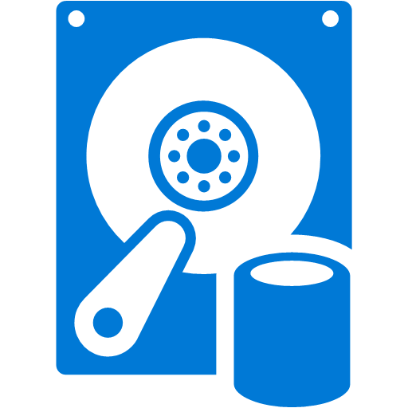
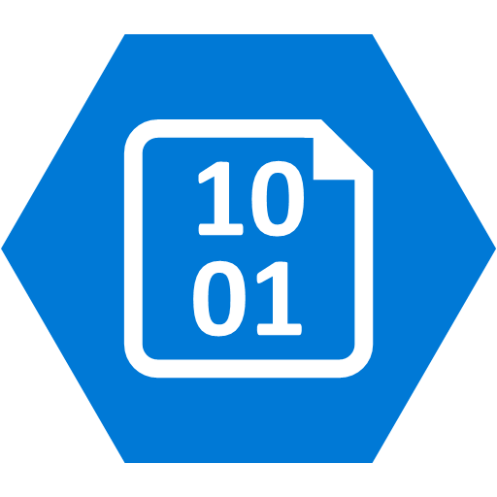
High Availability - Failover Configuration
traffic
probe
Availability Set
Storage Account
Storage Account
Witness
Primary
Secondary
Storage Account
Notes:
To qualify for the high availability SLA of 99.95% in Azure, you need to have at least two VMs and place these in a single Availability Set. This ensures the VMs are spread of over multiple Fault Domains. If a failure occurs in a Fault Domain, the VMs in other Fault Domains are not affected. An Availability Set contains up to 3 Fault Domains, so 3 VMs in the same Availability Set are all separated from each other.
In a Farm configuration all VMs in the Availability Set are active and can be reached by a client. If one fails, the other(s) just pickup more load. By contrast, if you have an active-passive cluster, only one VM is actively handling requests and the other is dormant. The Azure Load Balancer should only send traffic to the active node (or Primary). This is usually achieved by using a load balancer probe that checks for a response on a specific probe port. The passive node (or Secondary) should only respond if it has become the active node because the Primary is no longer active due to failure or updates. Failover configurations like this often include a Witness or observer that monitors for failure in the active node, and which initiates a failover if something goes wrong. The Witness should also be in the Availability Set unless you have a high available Witness configuration that monitors multiple systems. Note that each of the VMs uses a separate storage account. This too is a resiliency measure, as this ensures failure in a storage account only affects a single VM.
What you will see during the lifetime of a cluster is that the Primary and Secondary function switches periodically as updates to the Azure platform are rolled out. There is no deterministic way in which hosts are updated, so sometimes the Standby is updated first, resulting in one failover when the Primary is updated. In other cases the Primary is updated first, causing a failover, followed by another failover a while later when the new Primary is also updated.
Note that with some software the client is aware of both the Primary and Secondary instances. In that case there is no load balancer in play directing traffic. When a failover occurs the client switches to using the new Primary. Oracle Dataguard is an example where this is the case.

Slide 29
Oracle Database High Availability
Enterprise Edition: Oracle Data Guard
Standard Edition: Oracle Fail Safe
With Windows Failover Cluster and SIOS DataKeeper
Notes:
For production workloads on Oracle, High Availability is very important. In an on-prem data center the hardware is usually built to give very high uptime guarantees, and system administration is typically done in specific time windows. By contrast, in Azure you need to have at least two instances in an Availability Set to get an uptime SLA. Because of host updates, VM relocation, or other reasons, a VM may need to be restarted by Azure. System administrators do not control this. As a result, achieving High Availability requires software level mechanisms. With Oracle Database, you have two options: Data Guard or Fail Safe. Real Application Cluster (RAC) is not possible because there are no shared disk clusters in Azure
Data Guard is a well understood solution with different configuration options depending on your HA needs. For workloads running Oracle Enterprise Edition, this is the preferred solution. Oracle Standard Edition doesn’t support Data Guard, and therefore must rely on Oracle Fail Safe. Oracle Fail Safe requires Windows Server Failover Cluster (WSFC), and this usually works with a shared SAN. Because this is not available in Azure, you need a third party tool to perform disk replication like SIOS DataKeeper. SIOS is certified for Azure and Oracle.

Slide 30

SAP High Availability Example
Azure VNET
SIOS DataKeeper for WSFC without need of clustered shared disks
SAP App Server – ABAP/Java dual or single stack. Preferred smaller VMs
SAP Web Dispatcher installed on Azure VM, performs HTTP(S) load balancing
SQL DB with AlwaysOn Availability Group
Av. Set 3, WSFC
SAP Cen. Serv. Node 1
SAP Cen.. Serv. Node 2
Azure ILB
SAP SCS Cluster VNN
Av. Set 2
Domain Controller
Azure VM SAP Web Dispatcher
SAP App Server
SAP App Server
Av. Set 1, WSFC SQL AG
Sync Commit
Azure ILB AG Listener
SAP SQL DB WSFC node 1
SAP SQL DB WSFC node 2
Notes:
A highly available SAP system typically has the above layout
The SCS is protected with Window Server Failover Cluster. The SIOS DataKeeper (3rd party solution) enable the creation of a cluster on Azure without shared disks.
SAP Application servers are protected by virtue of multiplicity. The HTTP(S) load balancing is handled by the SAP Web Dispatcher built on an Azure VM. The SAP Logon load balancing is handled by the SCS message server.
The DB layer, for SQL Server DB, we use AlwaysOn Availability Group (AG) built on a WSFC leveraging node majority with a file share witness quorum.

Slide 31

Oracle Database HA/DR Configuration
VNET – Region 1
Port: 1521 (TNS)
Client
VNET – Region 2
Availability Set
Availability Set
Primary
Standby
Redo Stream
Redo Stream
RemoteStandby
Observer
Site-to-Site VPN
Notes:
With Data Guard you deploy a Primary database, and up to 30 Standby databases. As with Fail Safe, each Data Guard instance has its own set of disks, preferably in a different storage account. However, where with Fail Safe the disk replication is performed outside of the control of Oracle, with Data Guard Oracle takes care of transporting a Redo Stream to the Standby databases, so the changes to the Primary database can be applied to the Standby databases.
Standby databases can be Physical standby, Logical standby, or Snapshot standby databases. A Physical Standby database has the same disk and file configuration, which is the best option for a HA configuration because you then work with an exact replica on which the Redo Stream will directly be applied using Redo Apply. With Logical standby databases the Redo Stream is first converted to SQL statements that are executed against the standby using SQL Apply, and Snapshot standby databases are not updated constantly. Because Physical standby databases have the same physical layout, the performance will also be consistent with the Primary database.
In a HA configuration you usually work with a single Standby database, but you can use multiple standby databases as read-only replica’s to lighten the load on the primary database. As these serve a different function, it is possible to host these on a smaller VM size.
An Observer process is needed to accommodate automatic failover. The observer should be run on a separate VM, and by putting that VM in the same Availability Set as the Primary and Standby databases, you ensure it is in a different Update Domain and Fault Domain, and as such can’t be down at the same time as either the Primary or Standby databases.
When a failure of the Primary database occurs. The Observer comes in action and turns the Standby database into the Primary database. When the original Primary database comes back online, it becomes the Standby database.
What you will see during the lifetime of the cluster is that the Primary and Standby function switches periodically as updates to the Azure platform are rolled out. There is no deterministic way in which hosts are updated, so sometimes the Standby is updated first, resulting in one failover when the Primary is updated. In other cases the Primary is updated first, causing a failover, followed by another failover a while later when the new Primary is also updated.
Note that the client actually is aware of both instances. There is no load balancer in play directing traffic. The connection string points to both instances, and the designated Primary is the one the client talks to. When a failover occurs the client switches to using the new Primary. Most Oracle clients are capable of this behavior.
<Click>
Data Guard supports up to 30 Standby databases and you can use at least one of these for Disaster Recovery. For Disaster Recovery a Standby database is typically located in a different data center. In Azure you use a different region where you setup a second VNET, which you connect via Site-to-Site VPN. If your RPO lets you get away with data loss between minutes and an hour, a single Standby database in the second Azure region will suffice. Otherwise, you should setup two Standby databases in an Availability Set, so you ensure the least amount of data loss. Because the remote standby database is in a different region and the connection is over VPN, there is considerable latency involved. This means updates to the remote standby database(s) need to be done asynchronously, because the performance impact of synchronous updates would kill the performance of the Primary database.

Slide 32
Oracle Data Guard Considerations
HA: Maxium Protection
Redo Apply (Physical Standby)
SYNC Transport
AFFIRM
DR: Maximum Performance (ASYNC/NOAFFIRM)
Data Guard: http://bit.ly/Oracle12cDG
Protection Mode: http://bit.ly/Oracle12cDGPM
Notes:
Data Guard can be configured in different ways. For HA you need to have Zero Data Loss, and this is achieved by setting the right Protection Mode. Maximum Protection or Maximum Availability with SYNC Transport and Redo Apply ensure Zero Data Loss. The use of Redo Apply means that for HA you must use a Physical Standby. SYNC Transport ensures changes are sent to the Standby database immediately. You can then still choose when the Primary database continues processing. With AFFIRM it waits until the Redo Stream for a transaction is persisted to disk. With NOAFFIRM, a.k.a. FastSync, the Redo Stream can only be in memory of the Standby database before the Primary database continues. This obviously improves performance, but in case of dual failure could result in minor data loss.
For Disaster Recovery you use the Maximum Performance Protection Mode, which results in asynchronous transport and NOAFFIRM, so the Primary database can continue without waiting for the Standby database.

Slide 33
(Oracle Database) DR Alternatives
Azure Backup
Requires syncing Oracle backup timing
Windows: up to 3 backups per day
Linux: daily backups
Copy backups & archive logs to (RA-)GRS Storage
Higher frequency than Azure Backup
Non-deterministic geo-replication
Consider Azure Files
Notes:
Data Guard is a great solution for DR, but it comes at a price because of the secondary location. If the RPO is relaxed enough, you can use Azure Backup instead. With Azure Backup you can backup up to every 8 hours on Windows and daily on Linux. If you need a better RPO and thus a higher frequency, you could opt for copying the Archive Logs to an offsite location separately. Alternatively, you can attach additional disks with GRS or RA-GRS, or use Azure files, and copy backups and archive logs there. A downside to this approach is that geo-replication is non-deterministic, and copying large backup files may take a while to be copied to the paired region.
This doesn’t only apply to Oracle databases. Any workload that has its own internal backup system that stores files locally or on a share could potentially use Azure Backup and/or GRS storage.

Slide 34


SAP Central Server HADR
Azure VNET
On-prem Network
Domain controller
SCS DR VM
Domain Controller
WSFC Cluster VNN
Site-to-site or Express Route
SAP Cen. Serv. Node 1
SAP Cen. Serv. Node 2
Sync /sapmnt via jobs
Notes:
20 min left
To help protect the SAP components of ASCS/SCS/Central Services, you should:
Have an Active Directory server running in Azure. This Active Directory server would be the primary Active Directory server in case of a failover to the DR site. The Active Directory domain controller in Azure must be regularly synchronized with the on-premises Active Directory domain controllers.
While not running in Azure (the normal case), have a VM in Azure which is up and running for every running SAP ASCS/SCS/Central Services. If a DR event occurs, these VMs will take over the role of the ASCS/SCS/Central Services. You would need to make sure that the content of the sapmnt share(s) of the VMs running on-premises is copied on a regular basis into the VM(s) in Azure.
In case of a failover to the DR site, assume that the Active Directory server that has been in Azure or is rebuilt in Azure is taking over the Windows Domain services.
NOTE In this procedure, you make a change to the DNS entries for the Virtual Windows Cluster names by changing their IP addresses to the IP addresses of the VMs in Azure that should run ASCS/SCS/Central Services. You also assign the virtual name of the cluster to the VMs in Azure designated to run ASCS/SCS/Central Services.

Slide 35

SAP/SQL DR with AG Replicas on Azure
Run backups to Azure Storage
Azure VNET
Azure Storage
On-prem Network
SAP App Servers
Domain controller
DR SAP SQL DB Sec. Replica
WSFC SQL AG Listener
Sync
Commit
Site-to-site or Express Route
SAP SQL DB Prim. Replica WSFC node 1
SAP SQL DB Sec. Replica WSFC node 2
Cluster FSW
Asynchronous commit
Notes:
One of the most powerful hybrid scenarios we are making even easier to implement with SQL Server 2014 is a low recovery time objective (RTO) disaster recovery solution for your on-premises SQL Servers. You can do this by now being able to add AlwaysOn replicas directly to Microsoft Azure Virtual Machines. Now as you see in the diagram, we recommend having your asynchronous replicas residing in Azure VMs and your synchronous replica hosted in the same location. Again the reason for that is you want to minimize the impact on your primary, so having the synchronous close by is ideal. Now this is still a low RTO solution as the way asynchronous replication works, is as soon as the transaction is committed it is on it’s was to the replica in Azure, so data loss in minimal.
The other big gain in this scenario is that AlwaysOn replicas are readable so you can take advantage of the global Azure data center to strategically place the replicas (remember you can have up to 8 now with SQL Server 2014, double that of SQL Server 2012). This means faster global BI reporting in addition to a more cost effective disaster recovery solution.
We have built UI into SQL Server management studio to make the deployment of AlwaysOn replicas even easier regardless of the hosting location. Also SQL Database on-prem or on Azure can backup directly to Azure storage.

Slide 36
SQL AlwaysOn Failover
Notes:
See demo script in SQL AlwaysOn Failover.docx

Slide 37
Summary
Azure is suitable for complex production workloads
Make sure you understand licensing and support
Capacity Planning is not a 1-to-1 mapping
You can change capacity after deploying to Azure
Use HA best practices for resiliency
Use DR technology matching RPO/RTO

